Slide 1
Decision Trees
ADA AI/ML April, 2023

Slide 2
Introduction
Decision tree algorithms are simple yet efficient supervised learning algorithms wherein the data points are continuously split according to certain parameters and/or the problem that the algorithm is trying to solve.
Decision trees are used for both classification and regression.
Every decision tree includes a root node, some branches, and leaf nodes.

Slide 3
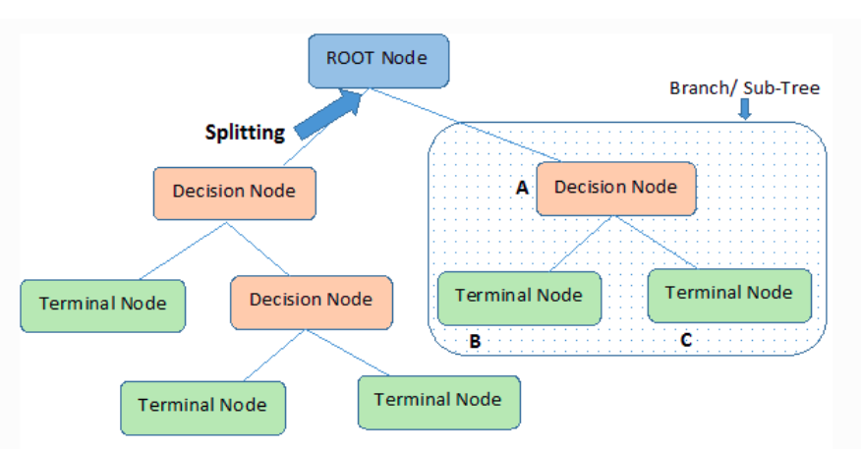
Introduction

Slide 4
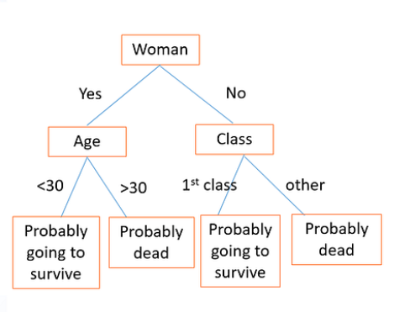
Introduction

Slide 5
Introduction
Root Node: It represents the entire population or sample and this further gets divided into two or more homogeneous sets.
Splitting: It is a process of dividing a node into two or more sub-nodes.
Decision Node: When a sub-node splits into further sub-nodes, then it is called the decision node.
Leaf / Terminal Node: Nodes do not split is called Leaf or Terminal node.
Pruning: When we remove sub-nodes of a decision node, this process is called pruning. You can say the opposite process of splitting.
Branch / Sub-Tree: A subsection of the entire tree is called branch or sub-tree.
Parent and Child Node: A node, which is divided into sub-nodes is called a parent node of sub-nodes whereas sub-nodes are the child of a parent node.

Slide 6
Introduction
Decision trees apply a top-down approach to the dataset that is fed during training.
The primary challenge in the decision tree implementation is to identify which attributes do we need to consider as the root node and each level. Handling this is to know as the attributes selection.
There are different algorithms and attributes selection measures to identify the attribute which can be considered as the root note at each level.

Slide 7
Assumptions
In the beginning, the whole training set is considered as the root.
Records are distributed recursively on the basis of attribute values.
Order to placing attributes as root or internal node of the tree is done by using some statistical approach.
The decision criteria are different for classification and regression trees.

Slide 8
Algorithms
The algorithm selection is based on the type of target variables. Some algorithms used in Decision Trees:
ID3 → (extension of D3)
C4.5 → (successor of ID3)
CART → (Classification And Regression Tree)
CHAID → (Chi-square automatic interaction detection Performs multi-level splits when computing classification trees)
MARS → (multivariate adaptive regression splines)

Slide 9
Algorithms
For instance, the CART algorithm builds decision trees using a top-down greedy search approach (makes the choice that seems to be the best at that moment not taking care about the optimal final solution).
Steps in CART algorithm:
It selects a root node based on Gini Index and Highest Information Gain
On each iteration, it calculates the Gini Index and Information gain for the next splitting
Again, It selects a node based on Lowest Gini Index or Highest I.G
Then it splits the dataset to produce the subsets of data
It continues to recur on each subset

Slide 10
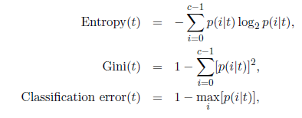
Split measures
The measures for the best split are often based on the degree of impurity of the child nodes. Impurity is a measure of homogeneity of data. Data is said to be pure or homogenous if it only contains a single class.
p(i|t) denotes the fraction of records belonging to class i at a given node t, and c is the number of classes

Slide 11
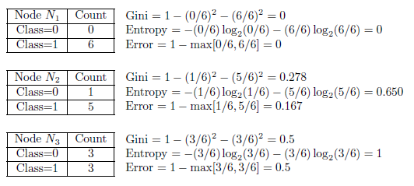
Split measures
Information gain refers to the decrease in entropy after a data-set is split on an attribute. Constructing a decision tree is all about finding an attribute that returns the highest information gain (i.e., the most homogeneous branches)

Slide 12
Pros & Cons (CART)
Pros:
Easy to interpret, understand, and visualize
Classification and regression trees are nonparametric and nonlinear.
Classification and regression trees implicitly perform feature selection.
Outliers have no meaningful effect on CART.
It requires minimal supervision and produces easy-to-understand models.
Data preparation during pre-processing requires less effort
Cons:
Overfitting.
High Variance.
The tree structure may be unstable (a small change in the data tends to cause a big difference in the tree structure).
Calculations involved can also become complex compared to other algorithms.

Slide 13
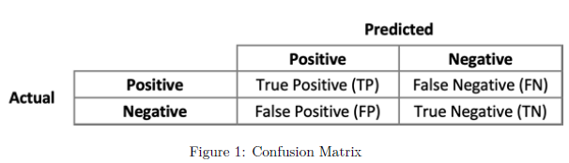
Classification evaluation metrics

Slide 14




Classification evaluation metrics

Slide 15
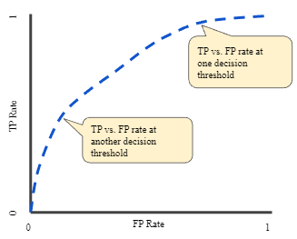


ROC Curve and AUC
An ROC curve (receiver operating characteristic curve) is a graph showing the performance of a classification model at all classification thresholds. This curve plots two parameters:
True positive rate (TPR; synonym for recall)
False positive rate (FPR)
A threshold is the probability or score at which the positive class is chosen over the negative class.
An ROC curve plots TPR vs. FPR at different classification thresholds. Lowering the classification threshold classifies more items as positive, thus increasing both False Positives and True Positives.

Slide 16
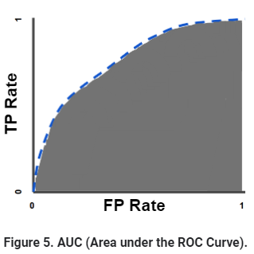
ROC Curve and AUC
To compute the points in an ROC curve, a model should be evaluated many times with different classification thresholds, but this would be inefficient.
However, there is an efficient, sorting-based algorithm that can provide us information about "Area under the ROC Curve" - AUC.
AUC measures the entire two-dimensional area underneath the entire ROC curve (think integral calculus) from (0,0) to (1,1).

Slide 17
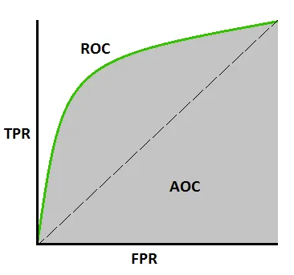
ROC Curve and AUC
AUC provides an aggregate measure of performance across all possible classification thresholds. One way of interpreting AUC is as the probability that the model ranks a random positive example more highly than a random negative example.
ROC curves are typically used in binary classification, where the TPR and FPR can be defined unambiguously. In the case of multiclass classification, a notion of TPR or FPR is obtained after binarizing the output. This can be done in 2 different ways:
the One-vs-Rest scheme
the One-vs-One scheme
The terms that are also used are: AUC-ROC curve, AUCROC

Slide 18
ROC Curve and AUC
AUC - ROC curve is a performance measurement for the classification problems at various threshold settings. ROC is a probability curve and AUC represents the degree or measure of separability.
It tells how much the model is capable of distinguishing between classes. Higher the AUC, the better the model is at predicting 0 classes as 0 and 1 classes as 1.

Slide 19
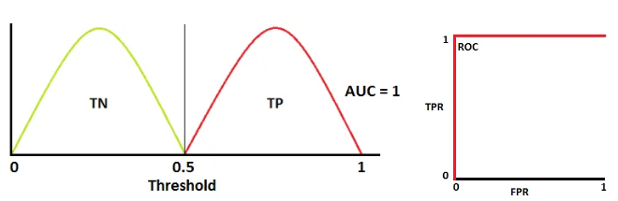
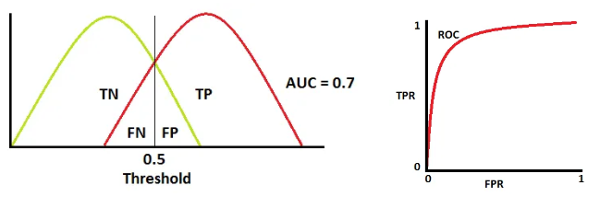
ROC Curve and AUC
An excellent model has AUC near to the 1 which means it has a good measure of separability.

Slide 20
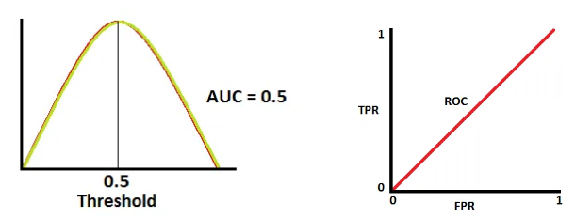
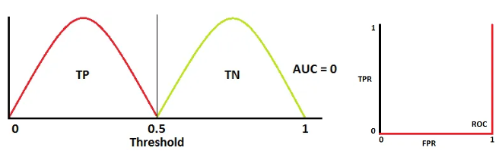
ROC Curve and AUC
A poor model has an AUC near 0 which means it has the worst measure of separability. In fact, it means it is reciprocating the result. It is predicting 0s as 1s and 1s as 0s. And when AUC is 0.5, it means the model has no class separation capacity whatsoever.

Slide 21
ROC Curve and AUC
AUC-ROC is convenient for the following reasons:
It is is scale-invariant. It measures how well predictions are ranked, rather than their absolute values.
It is classification-threshold-invariant. It measures the quality of the model's predictions irrespective of what classification threshold is chosen.
Limitations of AUC-ROC:
Scale invariance is not always desirable. For example, sometimes we really do need well calibrated probability outputs, and AUC won’t tell us about that.
Classification-threshold invariance is not always desirable. In cases where there are wide disparities in the cost of false negatives vs. false positives, it may be critical to minimize one type of classification error. For example, when doing email spam detection, you likely want to prioritize minimizing false positives (even if that results in a significant increase of false negatives). AUC isn't a useful metric for this type of optimization.

